Slide 1
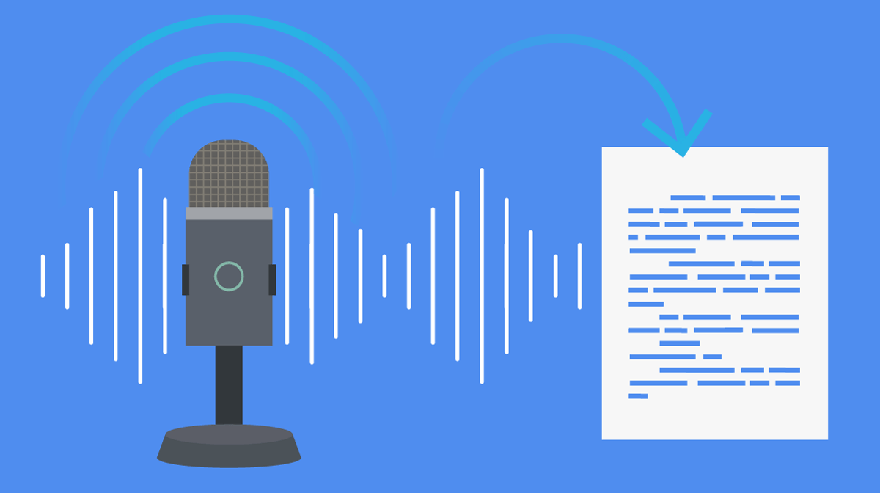
SPEECH-TO-TEXT
Submitted By:
Vigneshwar Muriki (801308750)
Veda Samhitha Dyawanapally (801311867)
Deepthi Gade (801313372)
Mounika Kasaragadda (801310485)

Slide 2
Description and Uses:
Speech to text, also known as speech recognition or voice recognition, is a process that uses advanced algorithms and machine learning models to convert spoken words into written text.
Applications for speech to text technology include automated speech and interview transcription, real-time closed captioning of live events, text dictation software(Dictation software is often used by people who prefer to speak rather than type, or who have difficulty using a keyboard due to physical disabilities or other conditions), and voice-activated control systems for various appliances and devices(Enable users to control various devices and appliances using voice commands rather than physical buttons or controls).

Slide 3
Libraries Used
Streamlit: A python library used for creating Web-apps
Speech-Recognition Library: A python library used for speech recognition.
Textblob:A python library used for natural language processing tasks including sentiment analysis
googleTrans: A python library used for google translation.

Slide 4



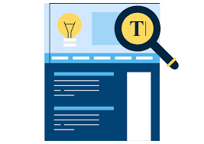

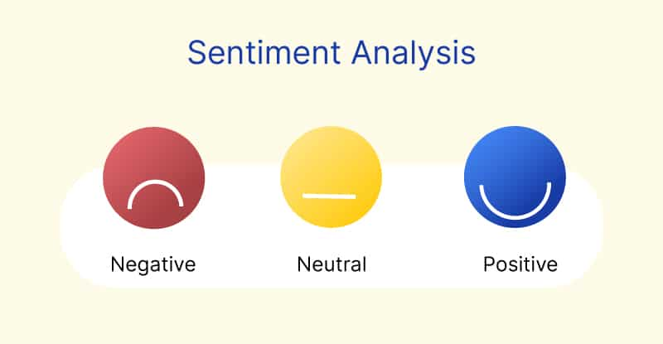

System Architecture
Speech Recognition(sr) library
to convert Audio to Text
Streamlit
Send Voice Input (sr.Recognizer() Object)
Transcribe it to text
Capture audio from the default microphone
Gives text as Output
sr.recognize_google(audio))
Audio Input
Highlight keywords in Yellow
User
Analyze Word Frequency
TextBlob for sentiment analysis
Sensitivity using Sentiment Analysis
Language Translation
Google Trans for translation

Slide 5
Implementation and Features
In our Code, with the help of the Speech Recognition Library, the code creates a straightforward web application that lets users record audio input from a microphone and turn it into text.
After that, the generated text is shown on the screen. The app has a single button to begin recording, and before the audio is captured, the microphone's sensitivity is changed.
An appropriate error message is displayed if the speech cannot be recognized or if the request cannot be processed properly. The "Speech to Text" app asks the user to speak after they click the "Start Recording" button, and the spoken words are then displayed as text on the screen.

Slide 6
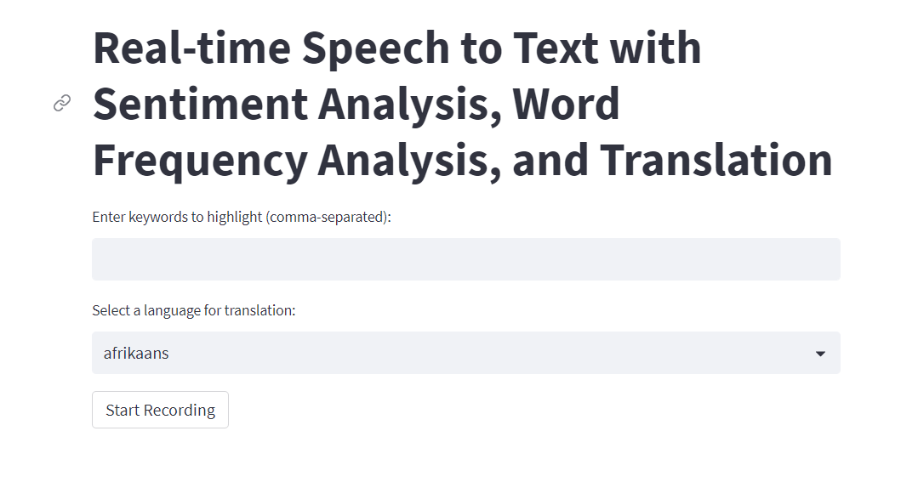
Home Page

Slide 7
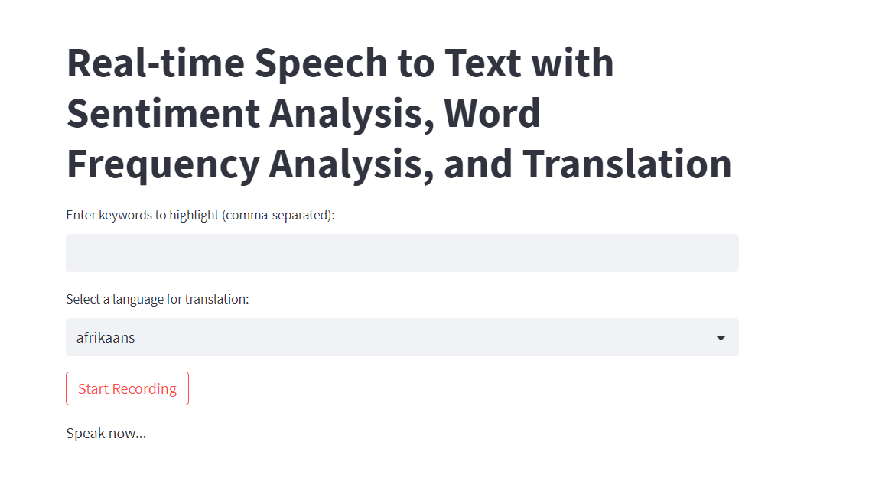
Test 1: Start recording and get ‘Speak now’ message.

Slide 8
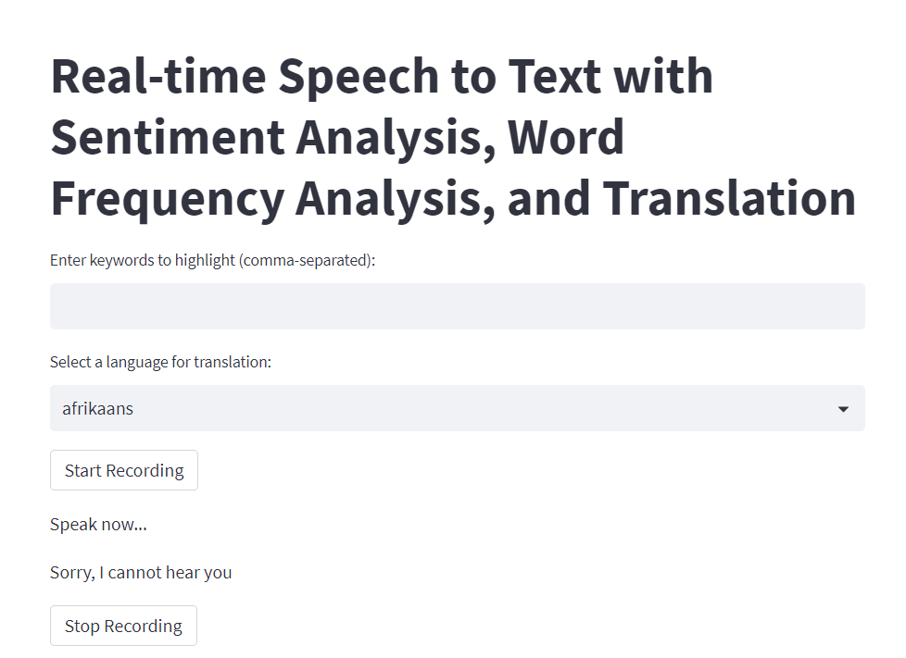
Test 2: Error check when no one talks.

Slide 9
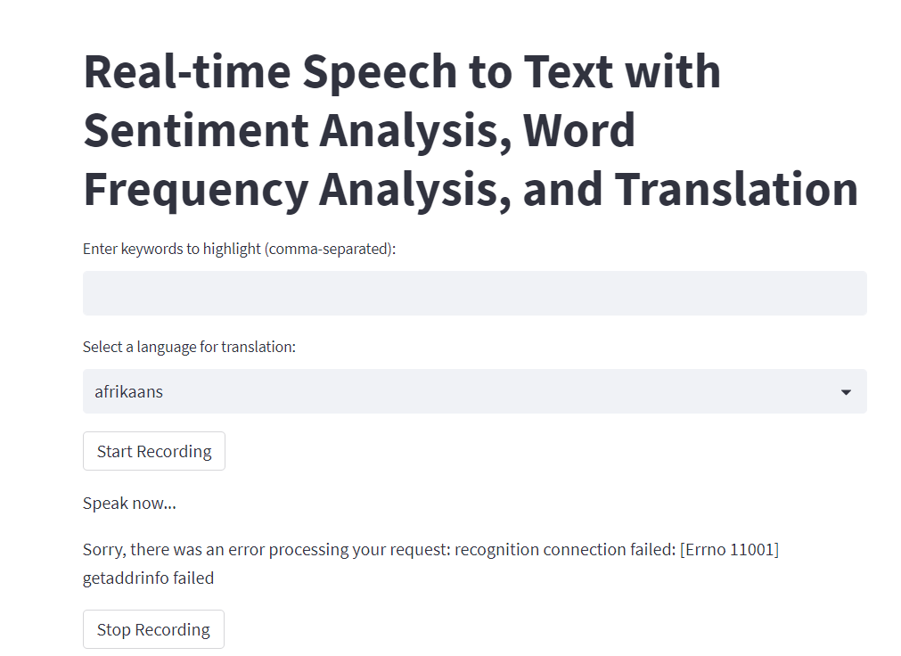
Test 3: Network Failure

Slide 10
Feature 1: Keyword Highlighting
We have added the feature that highlights keywords in Yellow and we can add as many keywords in the UI as per the usage of the project.
When certain words or phrases need to be highlighted to catch the user's attention or are particularly important, this feature may be helpful. For instance, a teacher might want to highlight important vocabulary words in the transcription text of a speech-to-text application for a language learning platform to aid their students in identifying and learning new words.

Slide 11
Feature 2: Detection of sensitivity of the transcribed text using Sentiment Analysis
The resulting text is displayed on the screen along with the sentiment analysis of the text.
This feature can be helpful in a variety of contexts where it's critical to comprehend the tone of the customer's voice, such as market research or customer service. The tone of the user's voice can be used to customize the response or course of action in personal assistants as well. The user experience can be enhanced by determining whether a text's sentiment is positive, negative, or neutral by conducting a sentiment analysis.

Slide 12
Feature 3: Language Translation
Speech to text translation involves turning spoken words in one language into written text in another. The spoken words are converted into text using speech recognition technology, and the text is then translated into the target language using machine translation algorithms.
Language learning, accessibility for people with hearing impairments, and real-time translation during multilingual meetings are just a few of the uses for services like Google Translate, Microsoft Translator, and Amazon Transcribe.

Slide 13
Feature 4: Analyze Word Frequency.
In speech to text, word frequency refers to how frequently a specific word or phrase appears in a given piece of spoken text that has been converted into written form. Word frequency analysis can offer insightful information about the text's content, style, and organization as well as the usage patterns and vocabulary of the speaker.
Marketing research, sentiment analysis, and language learning are just a few of the many uses for word frequency analysis. In order to prioritize their learning efforts and increase their vocabulary more effectively, learners can use word frequency lists to identify the most frequently used words in a language.

Slide 14
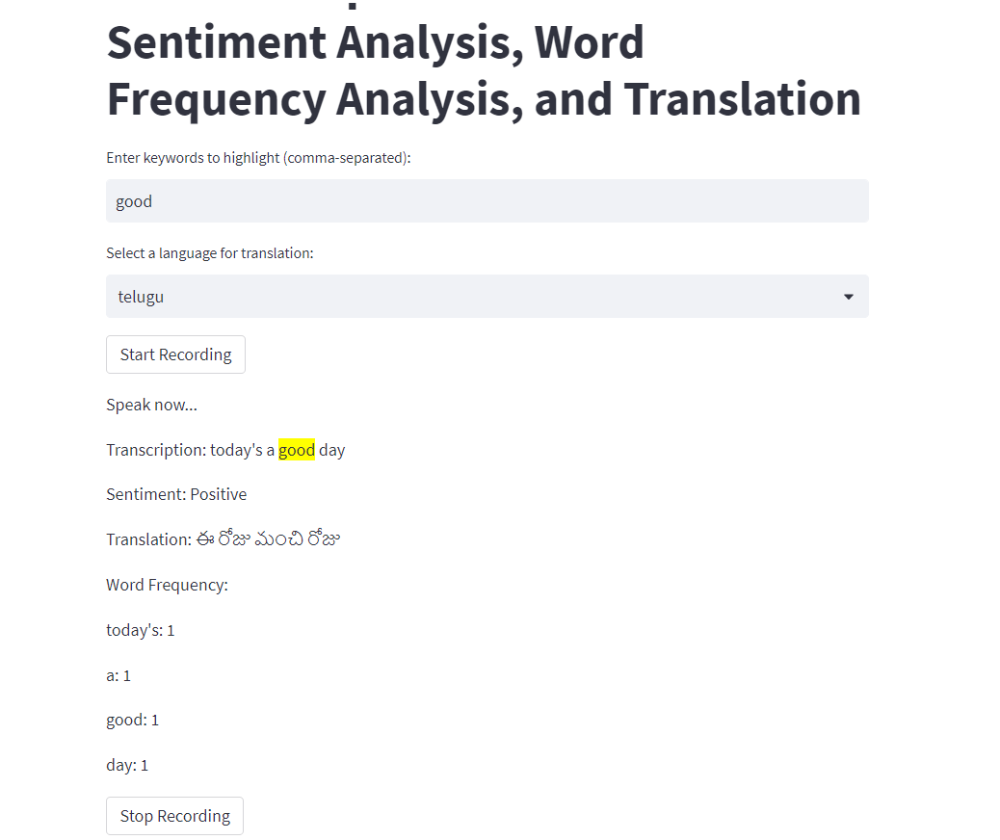
Screenshot 1:

Slide 15
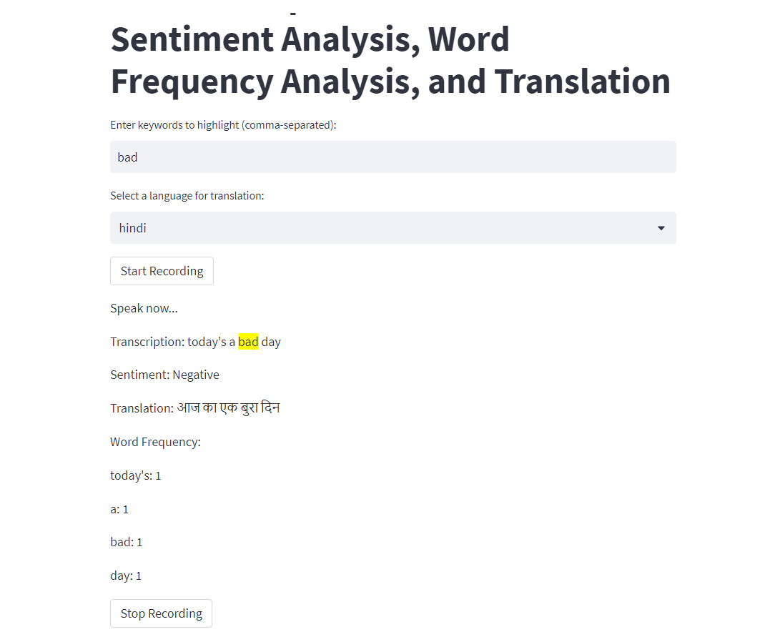
Screenshot 2:

Slide 16

Demo:

Slide 17
Challenges:
Changing the Project from ‘3D Human Modelling’ to ‘Speech-to-Text’ after Iteration 3 and implementing it.
Build dependency issues in Streamlit Cloud and Heroku.

Slide 18


